Slide 1
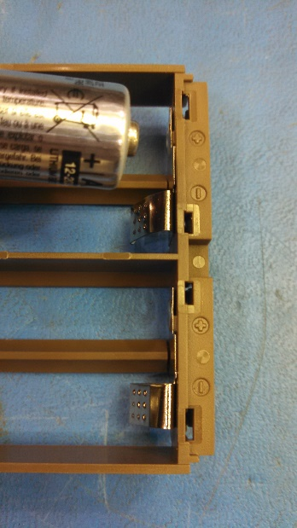
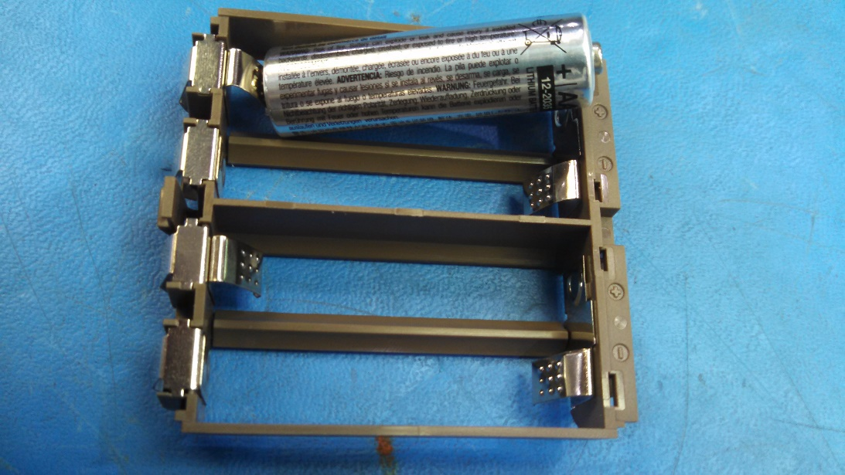
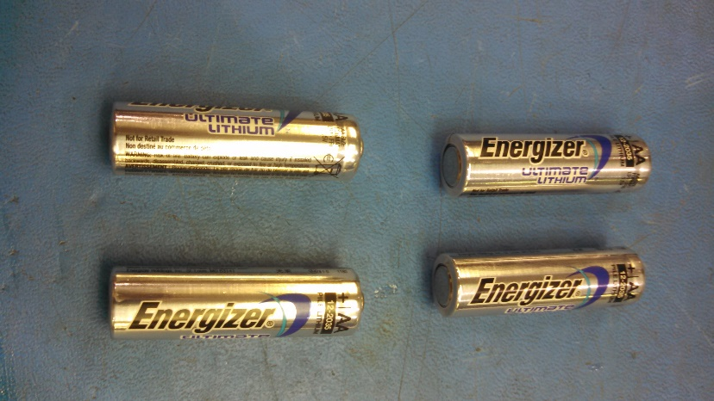
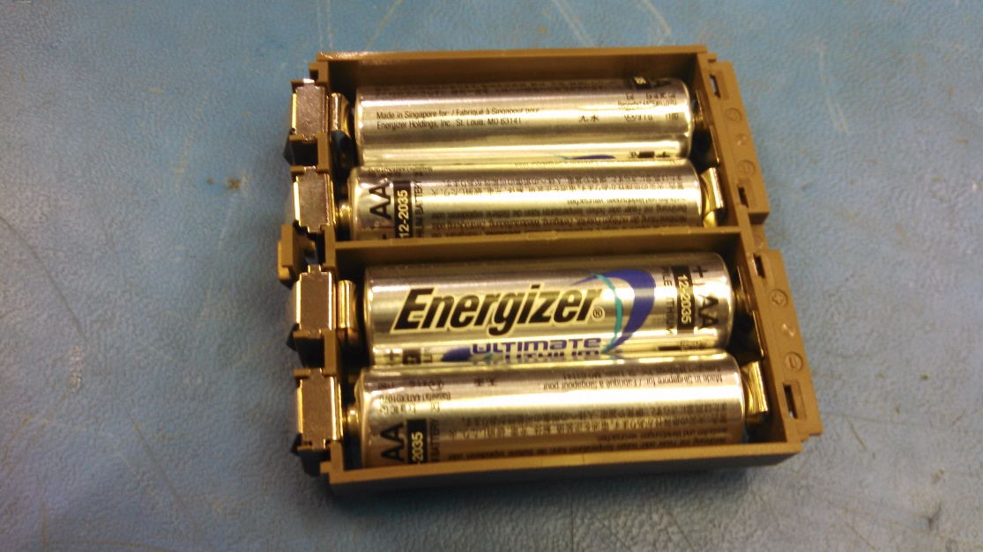
Ecovent Vent Assembly Instructions
Battery Pack Assembly
Install AA Batteries, PN 102-00067, qty. 4 into completed Battery Pack. Note the negative and positive orientation on the Battery Pack Housing
+
-
+
-
AA BATTERY
( PN 102-00067 ), qty. 4

Slide 2
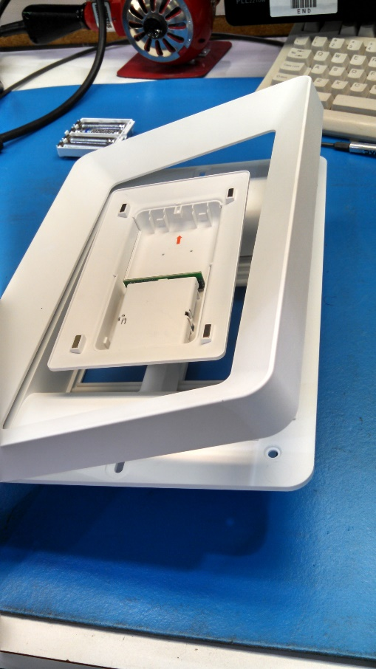
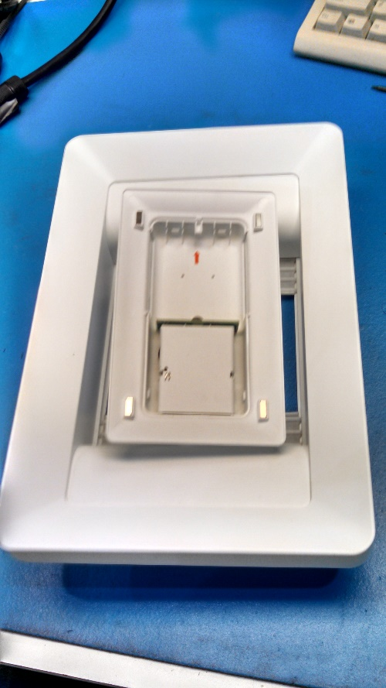
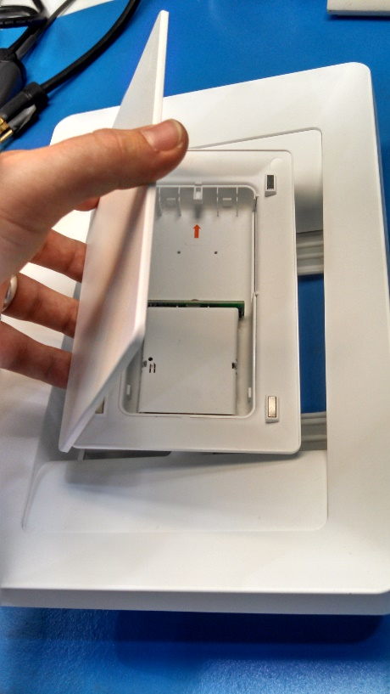
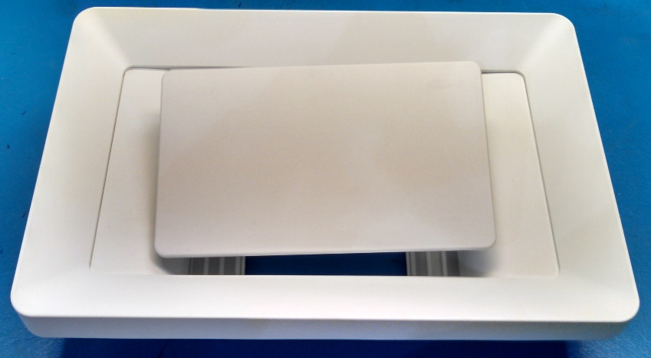
Check for 8 magnets and 8 screws
Install Vent Frame and Faceplate Cover. The magnetic force will hold these parts onto the vent.
Install Frame
Install Faceplate Cover

Slide 3
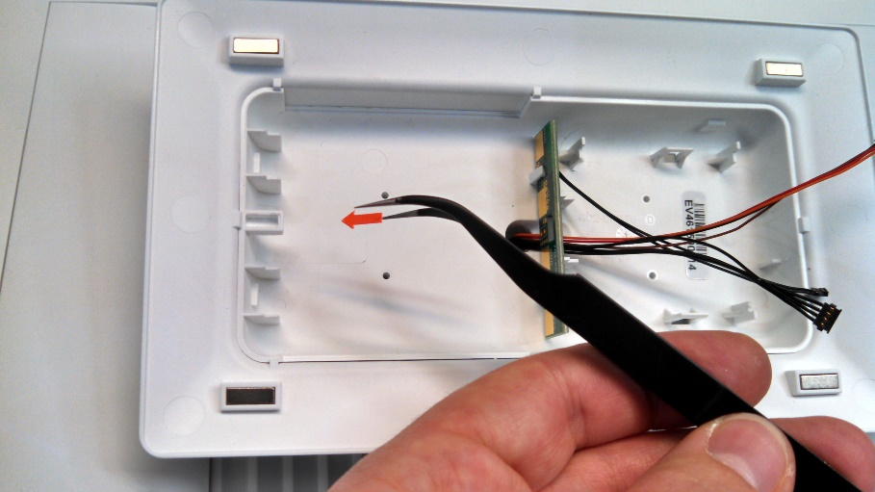
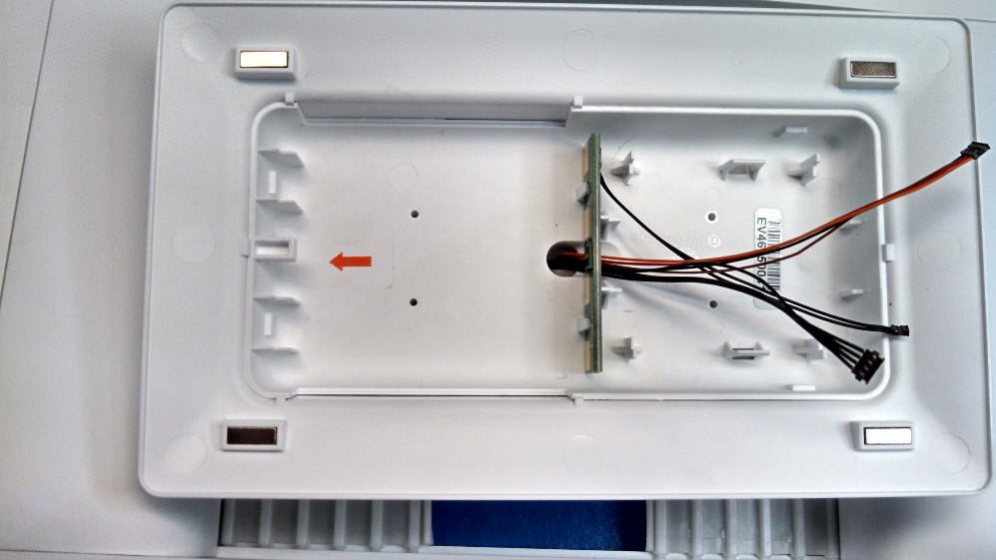
Vent Assembly
Install Battery Pack Orientation Arrow Label As Shown.

Slide 4
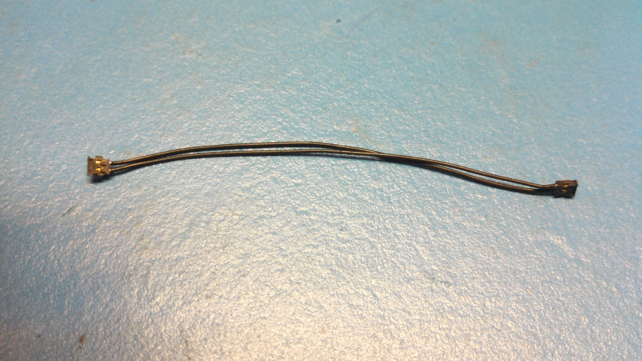
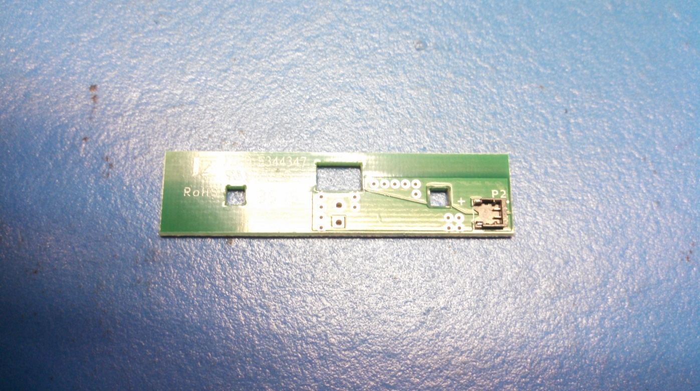

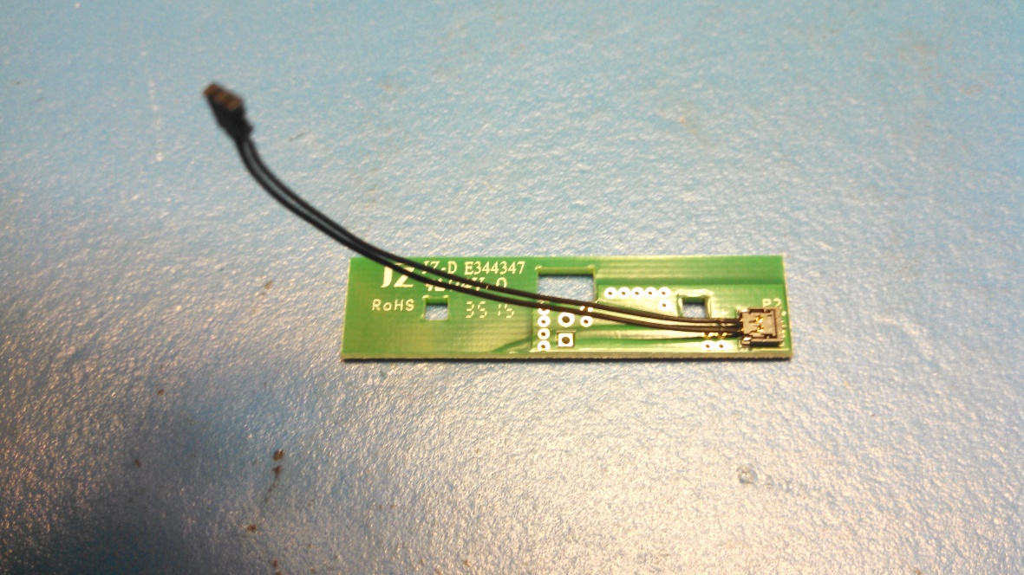
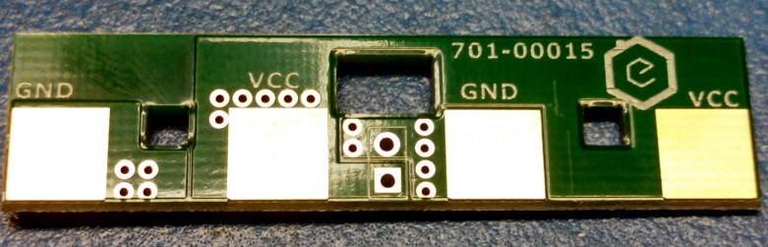
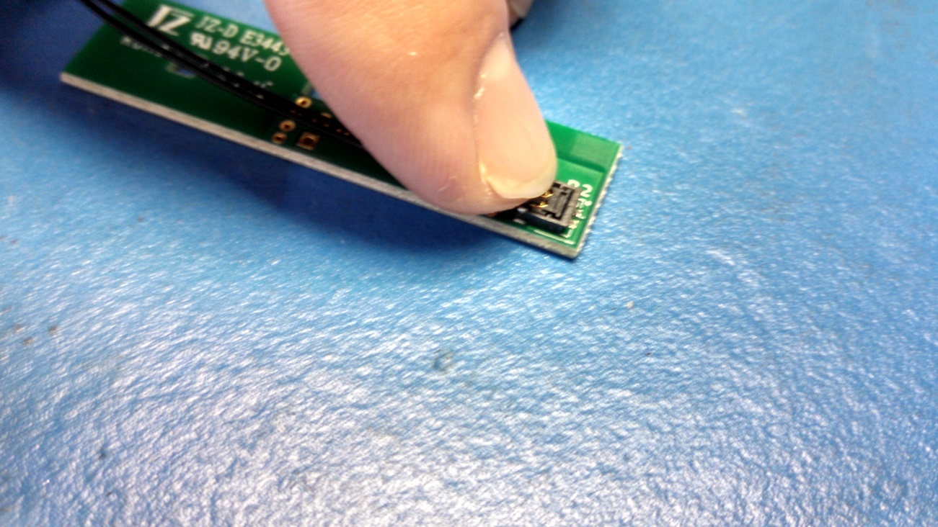

Vent Assembly
Snap the Cable, Vent Battery Power, PN 801-00033 into the connector on the Battery Cable PCA, PN 701-00015
+
Cable, Vent Battery Power
( PN 801-00033 )
Set aside for later assembly
Battery Connector PCA
( PN 701-00015 )

Slide 5
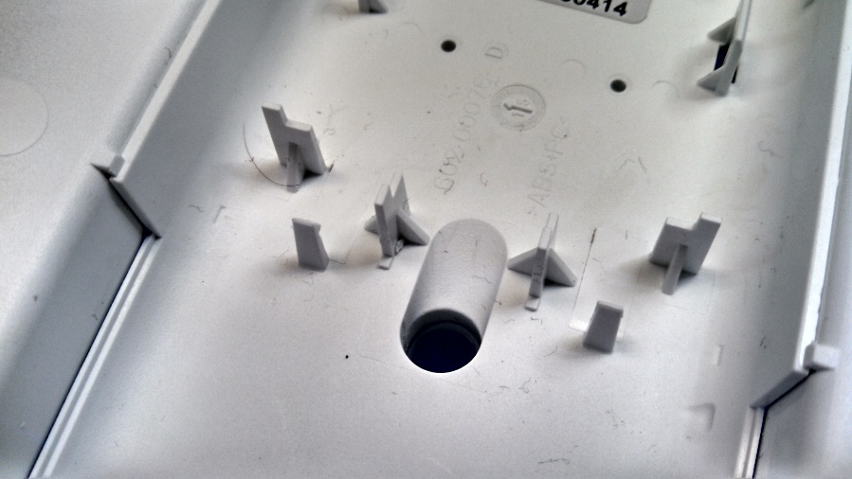
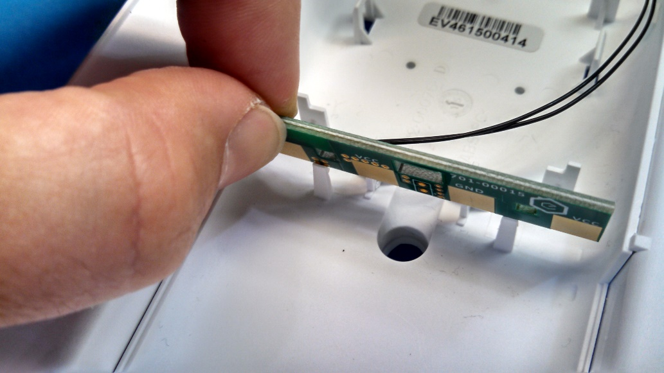
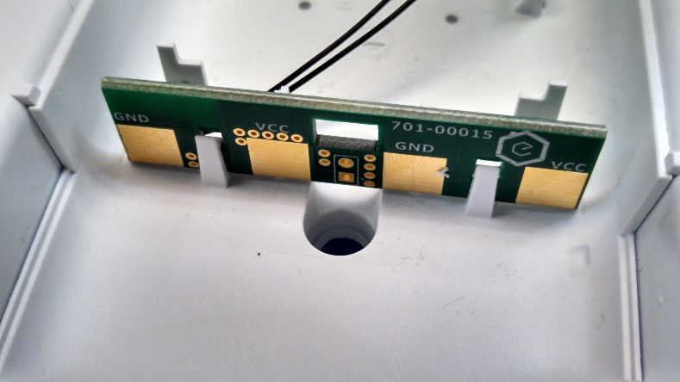
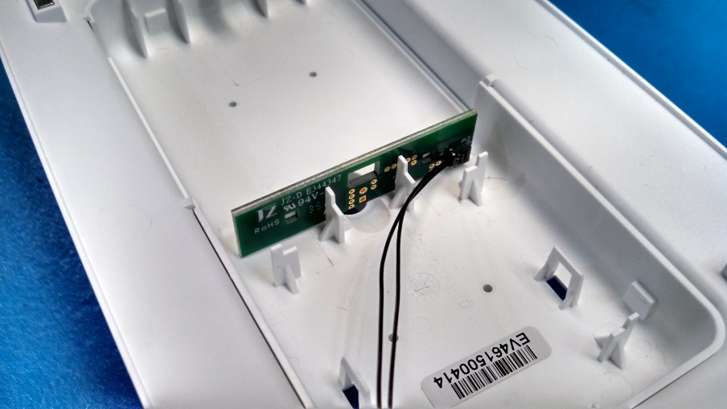
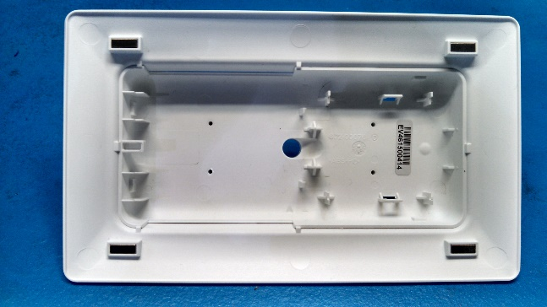

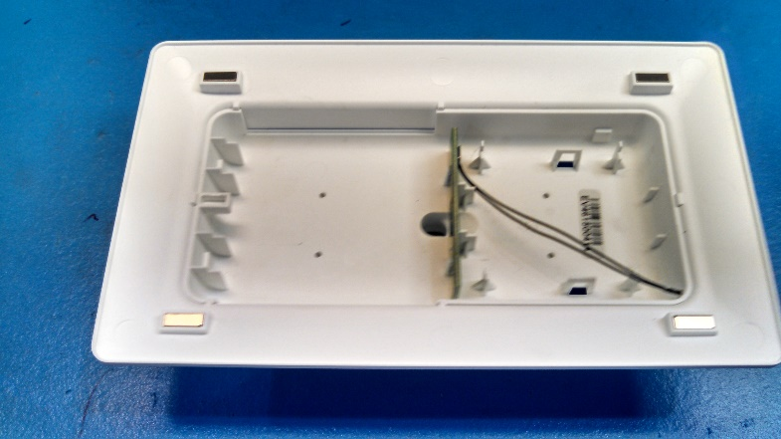
Vent Assembly
Install the Battery PCA & Battery Cable Assembly into the Balljoint Faceplate Wall/Ceiling & Faceplate Extension Assembly as shown.
Ensure the snaps (2 places) engage with the Battery PCA
Balljoint Faceplate Wall/Ceiling & Faceplate Extension Assembly
Battery PCA & Battery Cable Assembly

Slide 6
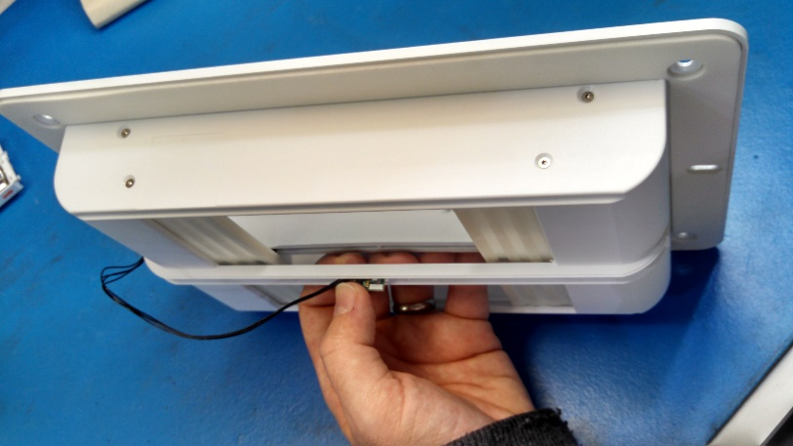
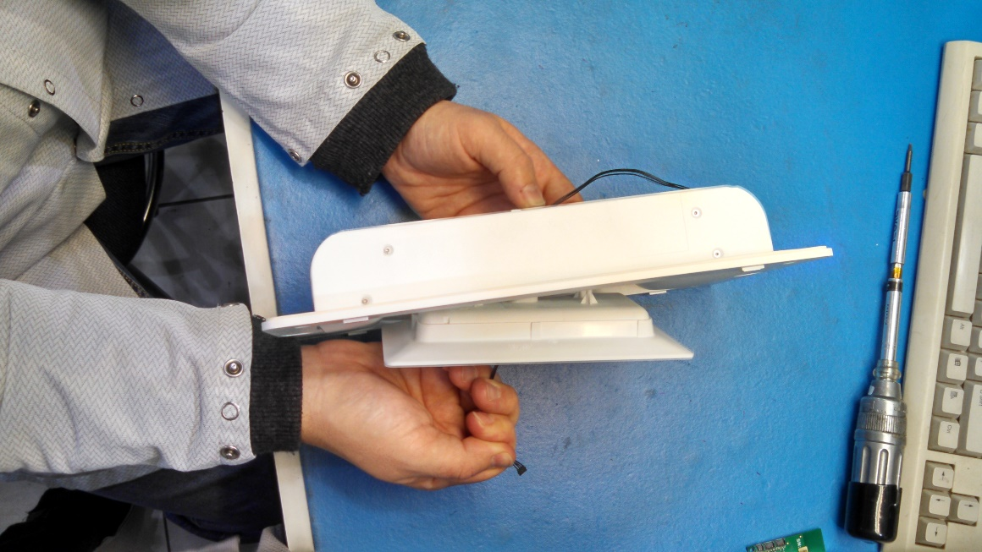
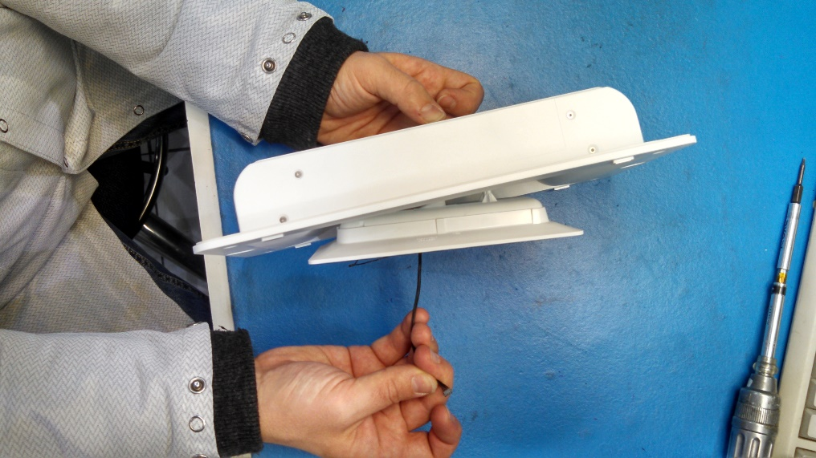
Vent Assembly
Gently pull excess cable through the vent so that the cable is flush to housing.
Excess Cable
Gently pull in direction shown

Slide 7
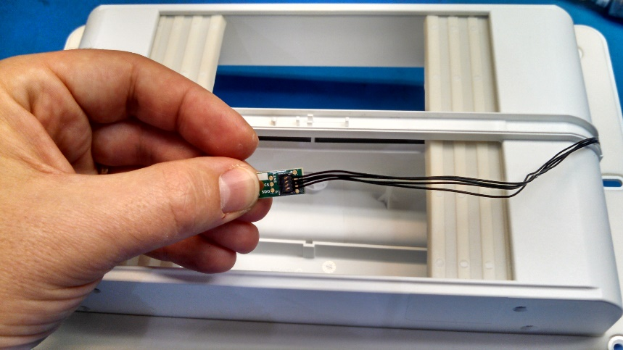
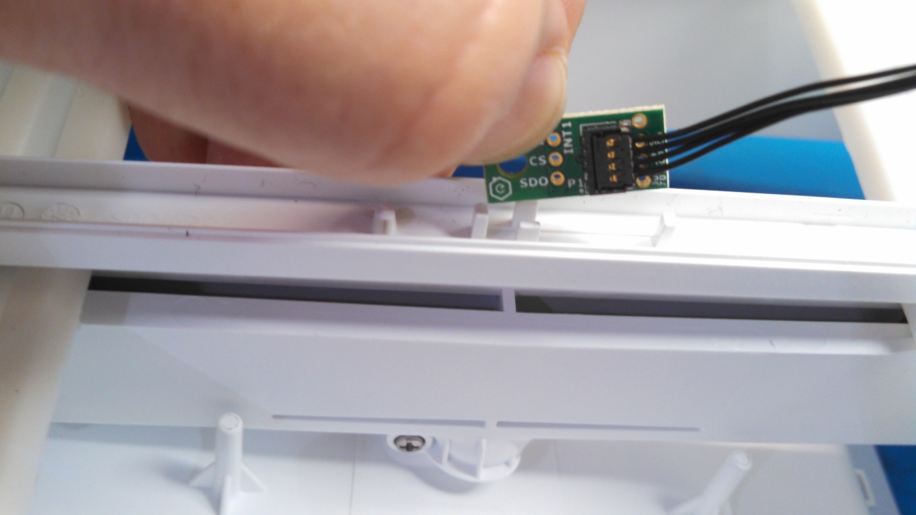
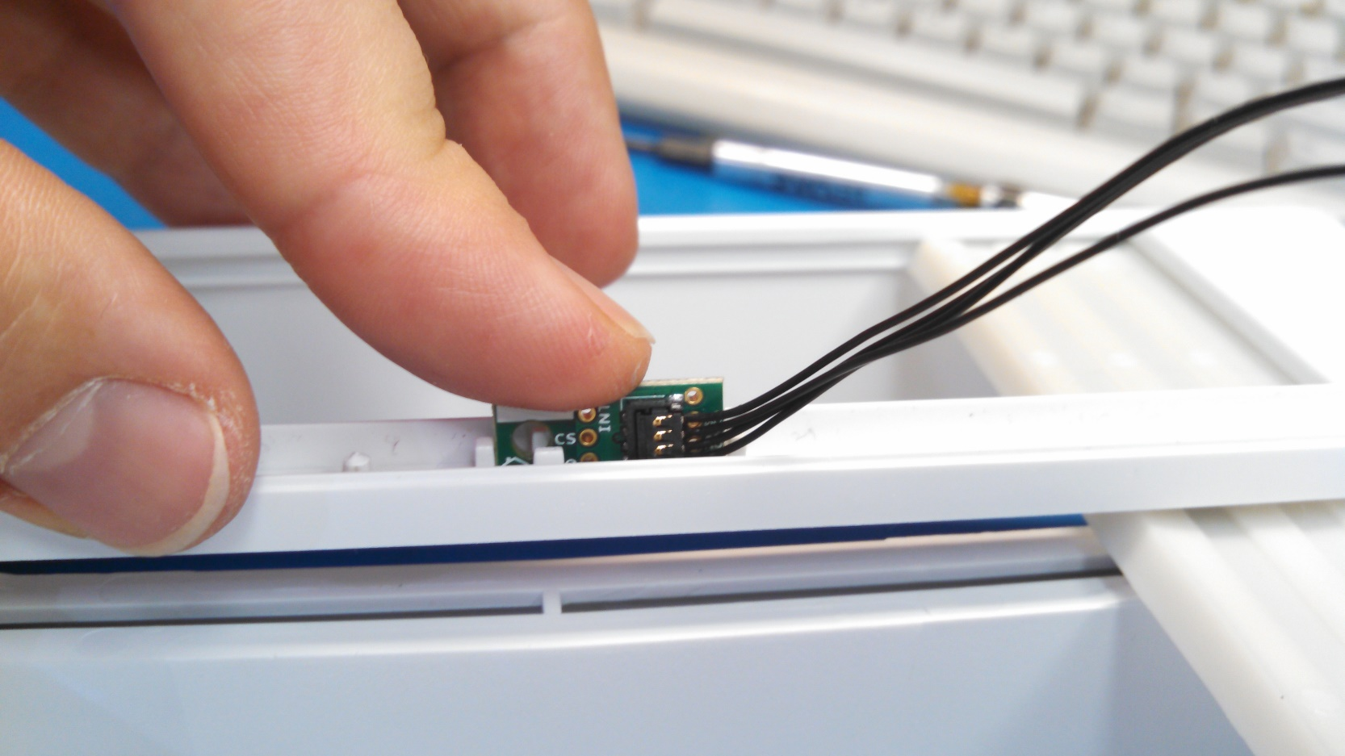
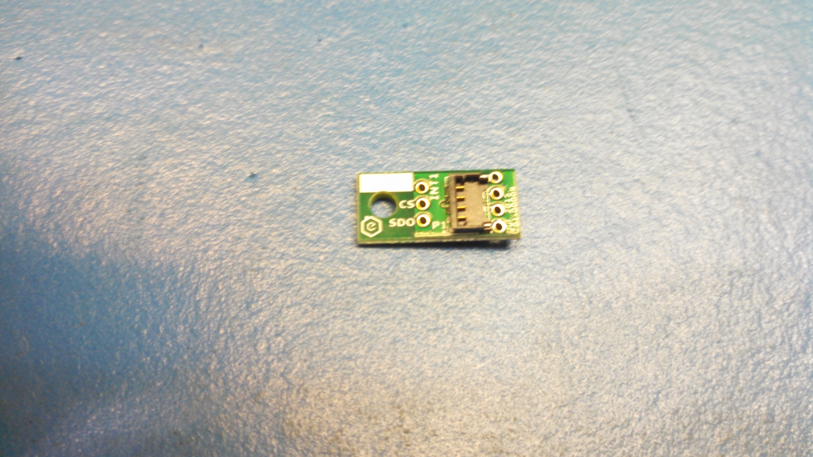
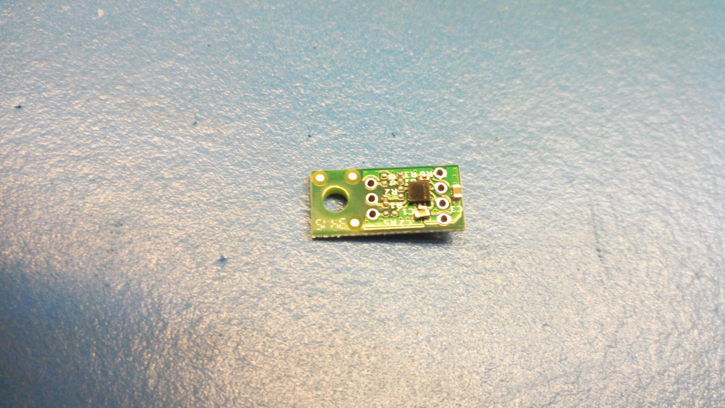
Vent Assembly
Flip Vent over. Install Pressure Sensor PCA by snapping Pressure Sensor Cable into Connector
Gently press Pressure Sensor PCA into its mounting position on the Outer Box
Pressure Sensor PCA
( PN 701-00009 ), qty. 1

Slide 8
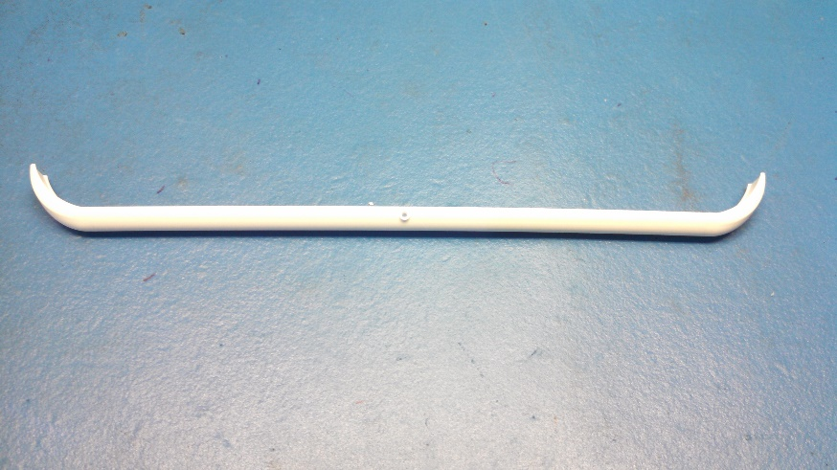
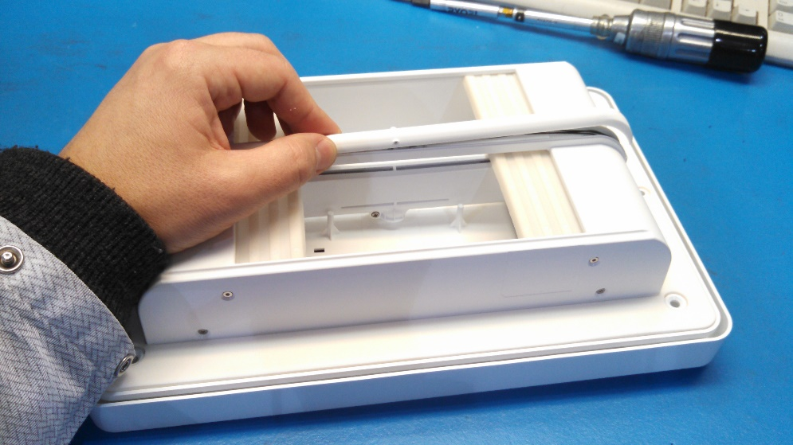
Vent Assembly
Place the Vent Pressure Sensor Cover 10 inch, PN 602-00082, onto the Outer Box. Install qty 4 m2.5x6 flat head scrw (602-00019) tightened to 40 +/- 4 in oz.
Proceed to FCT2
Vent Pressure Sensor Cover 10 inch
( PN 602-00082 ), qty. 1

Slide 9
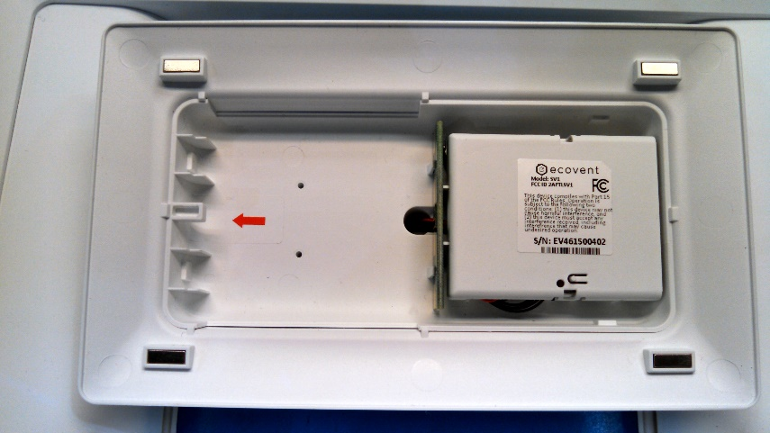
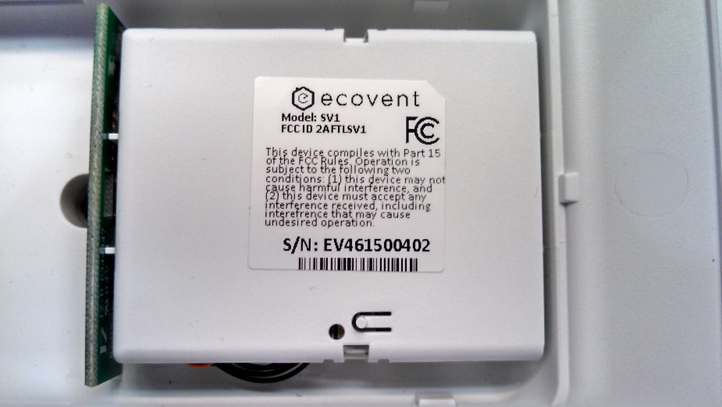
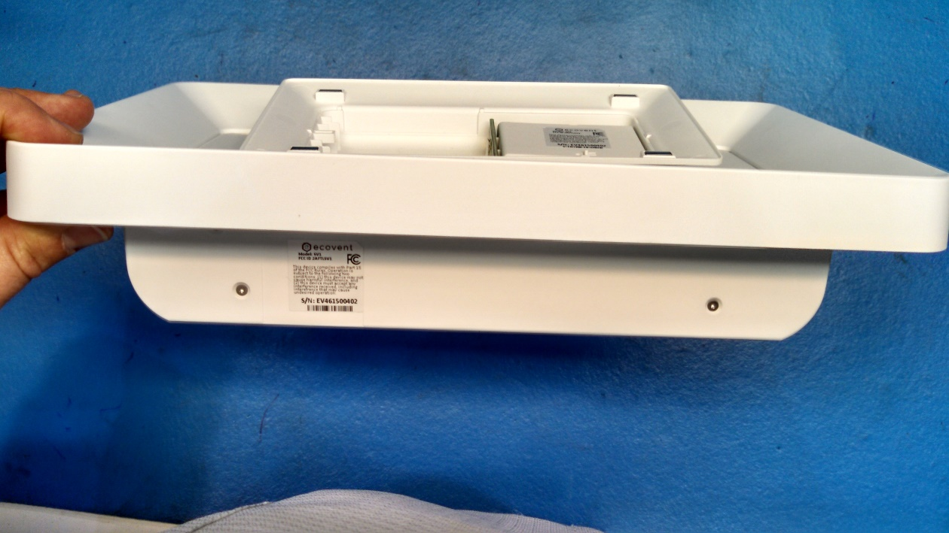
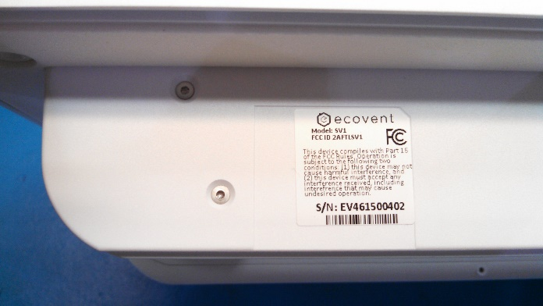
Vent Assembly
Perform FCT 2 before this step
Apply Vent Labels as shown.
Battery Pack Cover
Align cutout to feature in plastic, this corner.
Side of Vent

